Slide 1
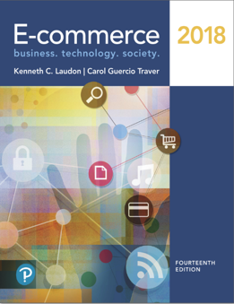
E-Commerce 2018: Business. Technology. Society
Fourteenth Edition
Chapter 5
E-Commerce Security and Payment Systems
Copyright © 2019, 2018, 2017 Pearson Education, Inc. All Rights Reserved
Notes:
If this PowerPoint presentation contains mathematical equations, you may need to check that your computer has the following installed:
1) MathType Plugin
2) Math Player (free versions available)
3) NVDA Reader (free versions available)

Slide 2
Learning Objectives
5.1 Understand the scope of e-commerce crime and security problems, the key dimensions of e-commerce security, and the tension between security and other values.
5.2 Identify the key security threats in the e-commerce environment.
5.3 Describe how technology helps secure Internet communications channels and protect networks, servers, and clients.
5.4 Appreciate the importance of policies, procedures, and laws in creating security.
5.5 Identify the major e-commerce payment systems in use today.
5.6 Describe the features and functionality of electronic billing presentment and payment systems.
Notes:
Slide 2 is list of textbook LO numbers and statements

Slide 3
Cyberwar: M A D 2.0
Class Discussion
What is the difference between cyberwar and cyberespionage?
Why has cyberwar become potentially more devastating in the past decade?
What damage can be done by cyberweapons like Stuxnet?
Is it possible to find a political solution to M A D 2.0?

Slide 4
The E-Commerce Security Environment
Overall size and losses of cybercrime unclear
Reporting issues
2017 survey: Average total cost of data breach to U.S. corporations was $21 million
Low-cost web attack kits
Online credit card fraud
Underground economy marketplace

Slide 5
What is Good E-Commerce Security?
To achieve highest degree of security
New technologies
Organizational policies and procedures
Industry standards and government laws
Other factors
Time value of money
Cost of security versus. potential loss
Security often breaks at weakest link

Slide 6
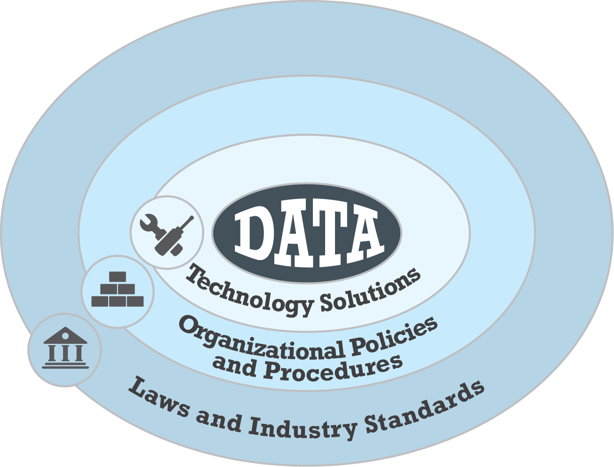
Figure 5.1 The E-Commerce Security Environment
Notes:
Figure 5.1, Page 262.
E-commerce security is multi-layered, and must take into account new technology, policies and procedures, and laws and industry standards.

Slide 7
Table 5.3 Customer and Merchant Perspectives on the Different Dimensions of E-Commerce Security
Dimension | Customer’s Perspective | Merchant’s Perspective
Integrity | Has information I transmitted or received been altered? | Has data on the site been altered without authorization? Is data being received from customers valid?
Nonrepudiation | Can a party to an action with me later deny taking the action? | Can a customer deny ordering products?
Authenticity | Who am I dealing with? How can I be assured that the person or entity is who they claim to be? | What is the real identity of the customer?
Confidentiality | Can someone other than the intended recipient read my messages? | Are messages or confidential data accessible to anyone other than those authorized to view them?
Privacy | Can I control the use of information about myself transmitted to an e-commerce merchant? | What use, if any, can be made of personal data collected as part of an e-commerce transaction? Is the personal information of customers being used in an unauthorized manner?
Availability | Can I get access to the site? | Is the site operational?

Slide 8
The Tension between Security and Other Values
Ease of use
The more security measures added, the more difficult a site is to use, and the slower it becomes
Public safety and criminal uses of the Internet
Use of technology by criminals to plan crimes or threaten nation-state

Slide 9
Security Threats in the E-Commerce Environment
Three key points of vulnerability in e-commerce environment:
Client
Server
Communications pipeline (Internet communications channels)

Slide 10
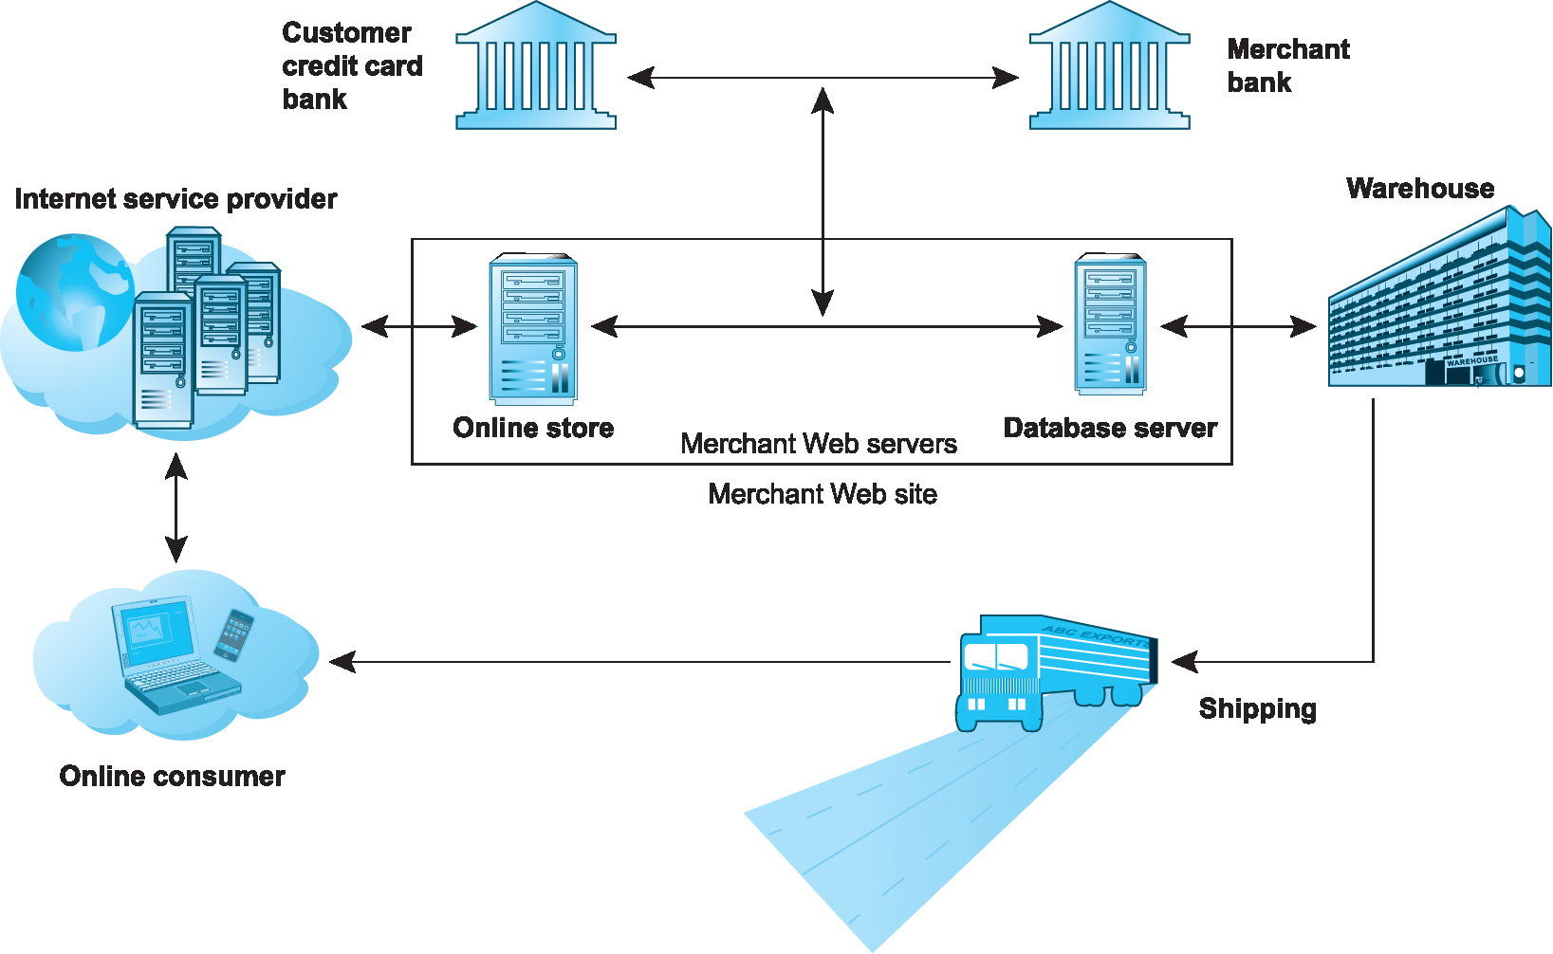
Figure 5.2 A Typical E-Commerce Transaction
Notes:
Figure 5.2, Page 266.
In a typical e-commerce transaction, the customer uses a credit card and the existing credit payment system.

Slide 11
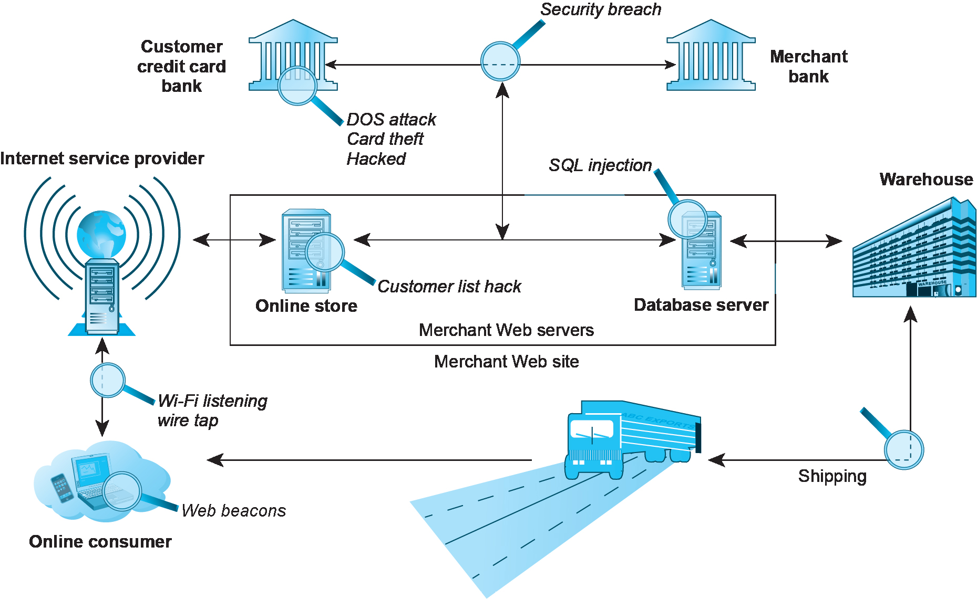
Figure 5.3 Vulnerable Points in an E-Commerce Transaction
Notes:
Figure 5.3, Page 267.
There are three major vulnerable points in e-commerce transactions: Internet communications, servers, and clients.

Slide 12
Malicious Code
Exploits and exploit kits
Malvertising
Drive-by downloads
Viruses
Worms
Ransomware
Trojan horses
Backdoors
Bots, botnets

Slide 13
Potentially Unwanted Programs
Browser parasites
Monitor and change user’s browser
Adware
Used to call pop-up ads
Spyware
Track’s users keystrokes, e-mails, I M s, etc.

Slide 14
Phishing
Any deceptive, online attempt by a third party to obtain confidential information for financial gain
Tactics
Social engineering
E-mail scams and B E C phishing
Spear phishing
Used for identity fraud and theft

Slide 15
Hacking, Cybervandalism, and Hacktivism
Hacking
Hackers versus. crackers
White hats, black hats, grey hats
Tiger teams
Goals: cybervandalism, data breaches
Cybervandalism:
Disrupting, defacing, destroying Web site
Hacktivism

Slide 16
Data Breaches
When organizations lose control over corporate information to outsiders
15 major breaches in 2016, 1.1 billion identities exposed
Yahoo and Equifax two of the most notorious
Leading causes
Hacking
Employee error/negligence
Accidental e-mail/Internet exposure
Insider theft

Slide 17
Insight on Society: Equifax: Really Big Data Hacked
Class Discussion
What organizational and technological failures led to the data breach at Equifax?
What technical solutions are available to combat data breaches?
Have you or anyone you know experienced a data breach?

Slide 18
Credit Card Fraud/Theft
Stolen credit card incidences about 0.9% on the Web and about 0.8% of mobile transactions
Hacking and looting of corporate servers is primary cause
Central security issue: establishing customer identity
E-signatures
Multi-factor authentication
Fingerprint identification

Slide 19
Identity Fraud/Theft
Unauthorized use of another person’s personal data for illegal financial benefit
Social security number
Driver’s license
Credit card numbers
Usernames/passwords
2016: Over 15 million U.S. consumers suffered identity fraud

Slide 20
Spoofing, Pharming, and Spam (Junk) Websites
Spoofing
Attempting to hide true identity by using someone else’s e-mail or I P address
Pharming
Automatically redirecting a web link to an different address, to benefit the hacker
Spam (junk) websites
Offer collection of advertisements for other sites, which may contain malicious code

Slide 21
Sniffing and Man-In-The-Middle Attacks
Sniffer
Eavesdropping program monitoring networks
Can identify network trouble spots
Can be used by criminals to steal proprietary information
E-mail wiretaps
Recording e-mails at the mail server level
Man-in-the-middle attack
Attacker intercepts and changes communication between two parties who believe they are communicating directly

Slide 22
Denial of Service (D o S) and Distributed Denial of Service (D D o S) Attacks
Denial of service (D o S) attack
Flooding website with pings and page request
Overwhelm and can shut down site’s web servers
Often accompanied by blackmail attempts
Botnets
Distributed Denial of Service (D D o S) attack
Uses hundreds or thousands of computers to attack target network
Can use devices from Internet of Things, mobile devices
D D o S smokescreening

Slide 23
Insider Attacks
Largest threat to business institutions come from insider embezzlement
Employee access to privileged information
Poor security procedures
Insiders more likely to be source of cyberattacks than outsiders

Slide 24
Poorly Designed Software
Increase in complexity of and demand for software has led to increase in flaws and vulnerabilities
S Q L injection attacks
Zero-day vulnerability
Heartbleed bug; Shellshock (BashBug); F R E A K

Slide 25
Social Network Security Issues
Social networks an environment for:
Viruses, site takeovers, identity fraud, malware-loaded apps, click hijacking, phishing, spam
Manual sharing scams
Sharing of files that link to malicious sites
Fake offerings, fake Like buttons, and fake apps

Slide 26
Mobile Platform Security Issues
Little public awareness of mobile device vulnerabilities
2016: 18 million mobile malware infections
Vishing
Smishing
S M S spoofing
Madware

Slide 27
Insight on Technology: Think Your Smartphone is Secure?
Class Discussion
What types of threats do smartphones face?
Are there any particular vulnerabilities to mobile devices
What qualities of apps make them a vulnerable security point in smartphone use
Are apps more or less likely to be subject to threats than traditional P C software programs?

Slide 28
Cloud Security Issues
D D o S attacks
Infrastructure scanning
Lower-tech phishing attacks yield passwords and access
Use of cloud storage to connect linked accounts
Lack of encryption and strong security procedures

Slide 29
Internet of Things Security Issues
Challenging environment to protect
Vast quantity of interconnected links
Near identical devices with long service lives
Many devices have no upgrade features
Little visibility into workings, data, or security

Slide 30
Technology Solutions
Protecting Internet communications
Encryption
Securing channels of communication
S S L, T L S, V P N s, Wi-Fi
Protecting networks
Firewalls, proxy servers, I D S, I P S
Protecting servers and clients
O S security, anti-virus software

Slide 31
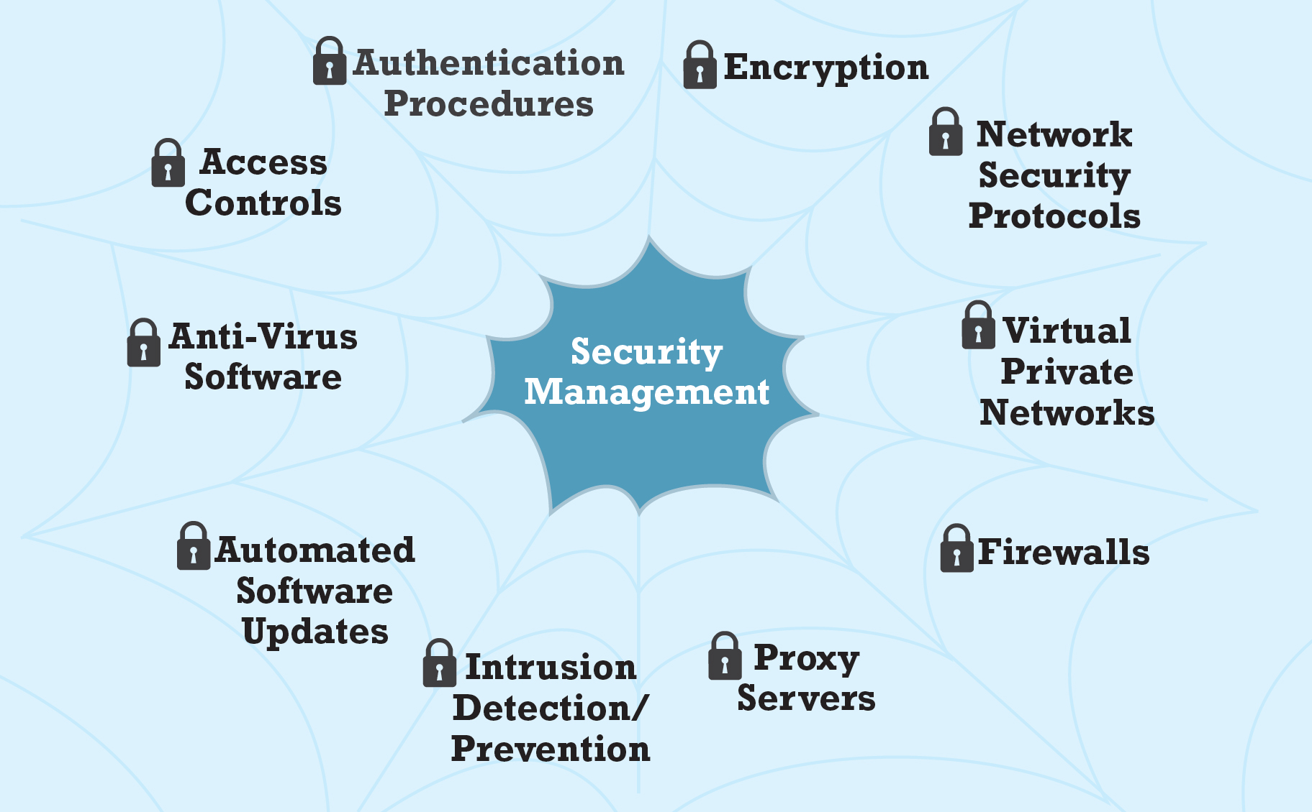
Figure 5.5 Tools Available to Achieve Site Security
Notes:
Figure 5.5, Page 290.
There are a number of tools available to achieve site security.

Slide 32
Encryption
Encryption
Transforms data into cipher text readable only by sender and receiver
Secures stored information and information transmission
Provides 4 of 6 key dimensions of e-commerce security:
Message integrity
Nonrepudiation
Authentication
Confidentiality

Slide 33
Symmetric Key Cryptography
Sender and receiver use same digital key to encrypt and decrypt message
Requires different set of keys for each transaction
Strength of encryption: Length of binary key
Data Encryption Standard (D E S)
Advanced Encryption Standard (A E S)
Other standards use keys with up to 2,048 bits

Slide 34
Public Key Cryptography
Uses two mathematically related digital keys
Public key (widely disseminated)
Private key (kept secret by owner)
Both keys used to encrypt and decrypt message
Once key used to encrypt message, same key cannot be used to decrypt message
Sender uses recipient’s public key to encrypt message; recipient uses private key to decrypt it

Slide 35
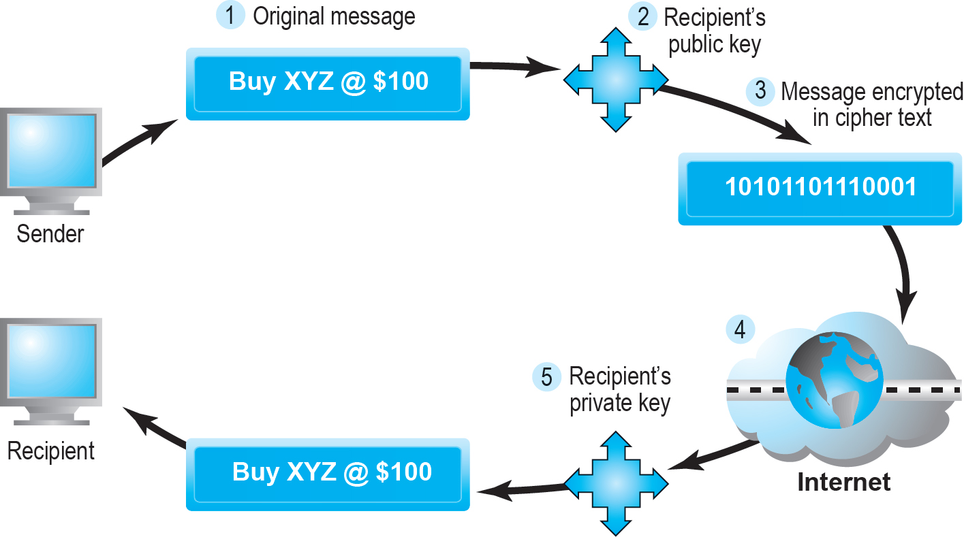
Figure 5.6 Public Key Cryptography: A Simple Case
Notes:
Figure 5.6, Page 293.
In the simplest use of public key cryptography, the sender encrypts a message using the recipient’s public key, and then sends it over the Internet. The only person who can decrypt this message is the recipient, using his or her private key. However, this simple case does not ensure integrity or an authentic message.

Slide 36
Public Key Cryptography Using Digital Signatures and Hash Digests
Sender applies a mathematical algorithm (hash function) to a message and then encrypts the message and hash result with recipient’s public key
Sender then encrypts the message and hash result with sender’s private key—creating digital signature—for authenticity, nonrepudiation
Recipient first uses sender’s public key to authenticate message and then the recipient’s private key to decrypt the hash result and message

Slide 37
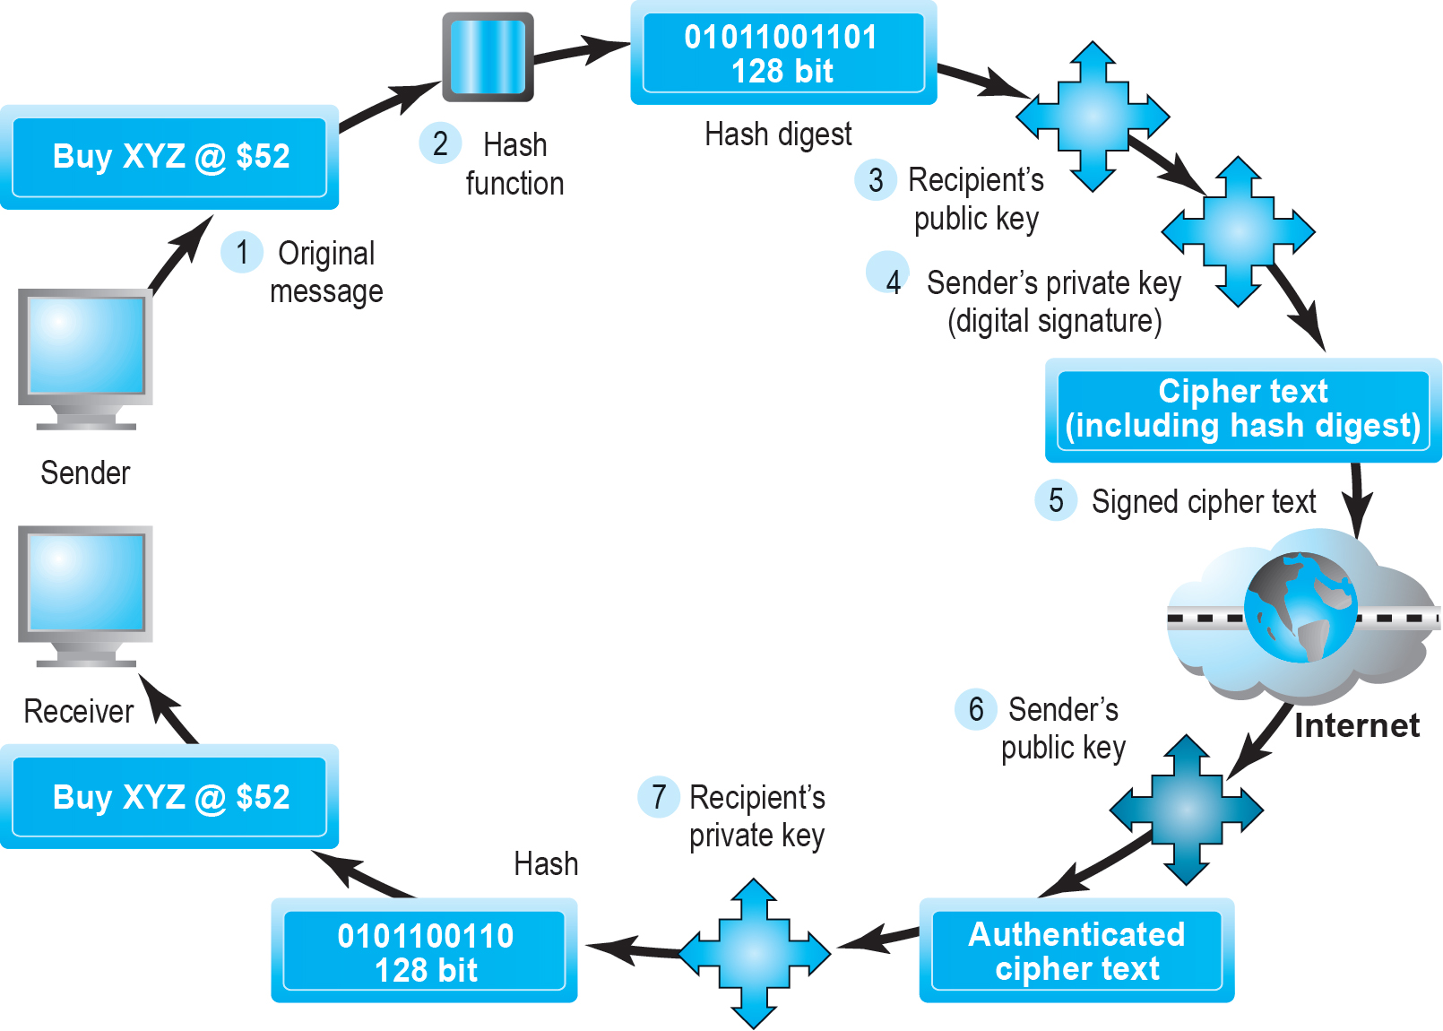
Figure 5.7 Public Key Cryptography with Digital Signatures
Notes:
Figure 5.7, Page 295.
A more realistic use of public key cryptography uses hash functions and digital signatures to both ensure the confidentiality of the message and authenticate the sender. The only person who could have sent the above message is the owner or the sender using his/her private key. This authenticates the message. The hash function ensures the message was not altered in transit. As before, the only person who can decipher the message is the recipient, using his/her private key.

Slide 38
Digital Envelopes
Address weaknesses of:
Public key cryptography
Computationally slow, decreased transmission speed, increased processing time
Symmetric key cryptography
Insecure transmission lines
Uses symmetric key cryptography to encrypt document
Uses public key cryptography to encrypt and send symmetric key

Slide 39
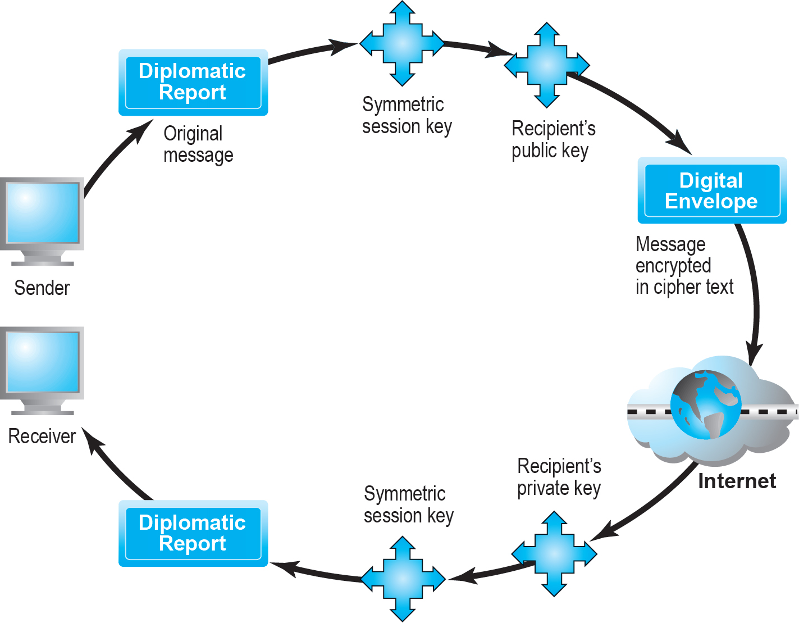
Figure 5.8 Creating a Digital Envelope
Notes:
Figure 5.8, Page 296.
A digital envelope can be created to transmit a symmetric key that will permit the recipient to decrypt the message and be assured the message was not intercepted in transit.

Slide 40
Digital Certificates and Public Key Infrastructure (P K I)
Digital certificate includes:
Name of subject/company
Subject’s public key
Digital certificate serial number
Expiration date, issuance date
Digital signature of C A
Public Key Infrastructure (P K I):
C A s and digital certificate procedures
P G P

Slide 41
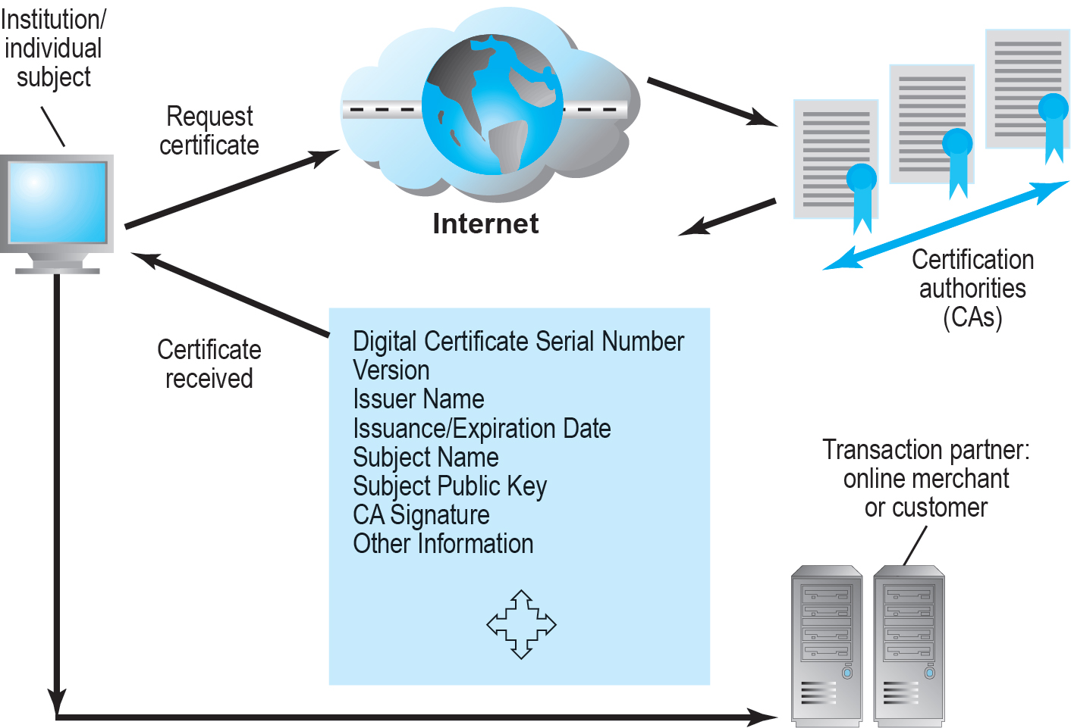
Figure 5.9 Digital Certificates and Certification Authorities
Notes:
Figure 5.9, Page 297.
The PKI includes certification authorities that issue, verify, and guarantee digital certificates that are used in e-commerce to assure the identity of transaction partners.

Slide 42
Limitations of P K I
Doesn’t protect storage of private key
P K I not effective against insiders, employees
Protection of private keys by individuals may be haphazard
No guarantee that verifying computer of merchant is secure
C A s are unregulated, self-selecting organizations

Slide 43
Securing Channels of Communication
Secure Sockets Layer (S S L)/Transport Layer Security (T L S)
Establishes secure, negotiated client–server session
Virtual Private Network (V P N)
Allows remote users to securely access internal network via the Internet
Wireless (Wi-Fi) networks
W P A 2

Slide 44
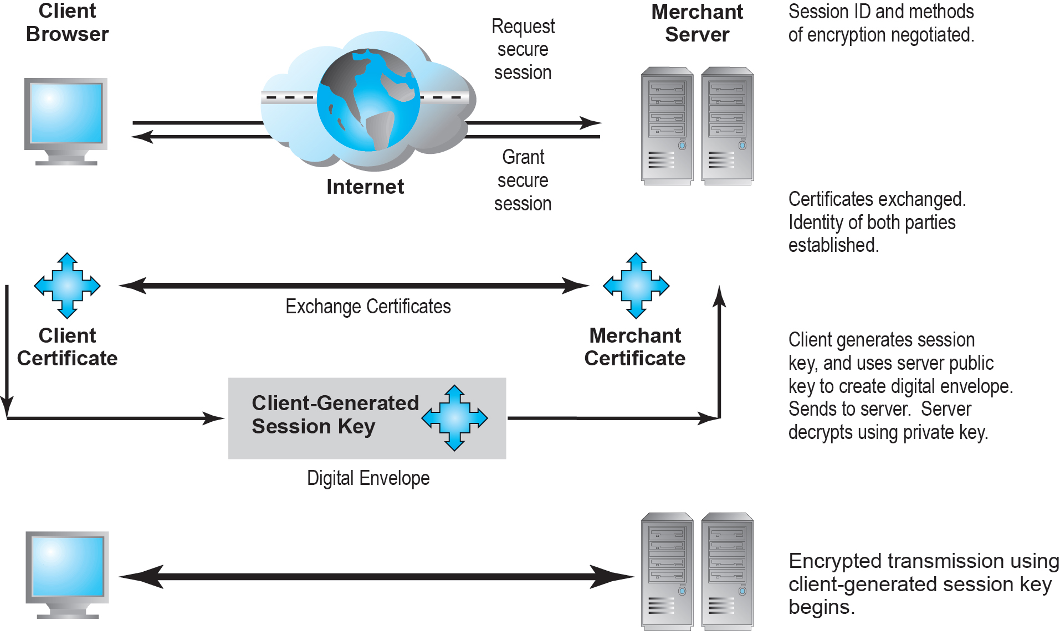
Figure 5.10 Secure Negotiated Sessions Using S S L/T L S
Notes:
Figure 5.10, Page 300.
Certificates play a key role in using SSL/TLS to establish a secure communications channel.

Slide 45
Protecting Networks
Firewall
Hardware or software that uses security policy to filter packets
Packet filters
Application gateways
Next-generation firewalls
Proxy servers (proxies)
Software servers that handle all communications from or sent to the Internet
Intrusion detection systems
Intrusion prevention systems

Slide 46
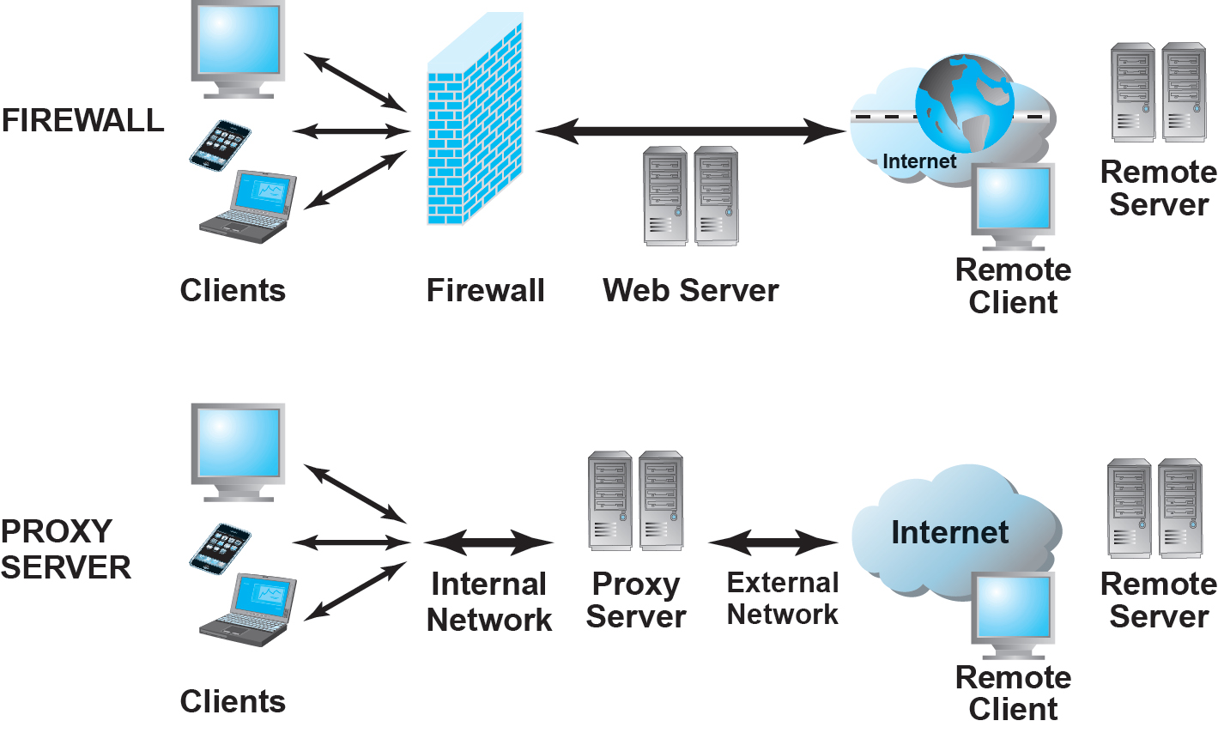
Figure 5.11 Firewalls and Proxy Servers
Notes:
Figure 5.11, Page 303.
The primary function of a firewall is to deny access by remote client computers to local computers. The primary purpose of a proxy server is to provide controlled access from local computers to remote computers.

Slide 47
Protecting Servers and Clients
Operating system security enhancements
Upgrades, patches
Anti-virus software
Easiest and least expensive way to prevent threats to system integrity
Requires daily updates

Slide 48
Management Policies, Business Procedures, and Public Laws
Worldwide, companies spend more than $86 billion on security hardware, software, services
Managing risk includes:
Technology
Effective management policies
Public laws and active enforcement

Slide 49
A Security Plan: Management Policies
Risk assessment
Security policy
Implementation plan
Security organization
Access controls
Authentication procedures, including biometrics
Authorization policies, authorization management systems
Security audit

Slide 50
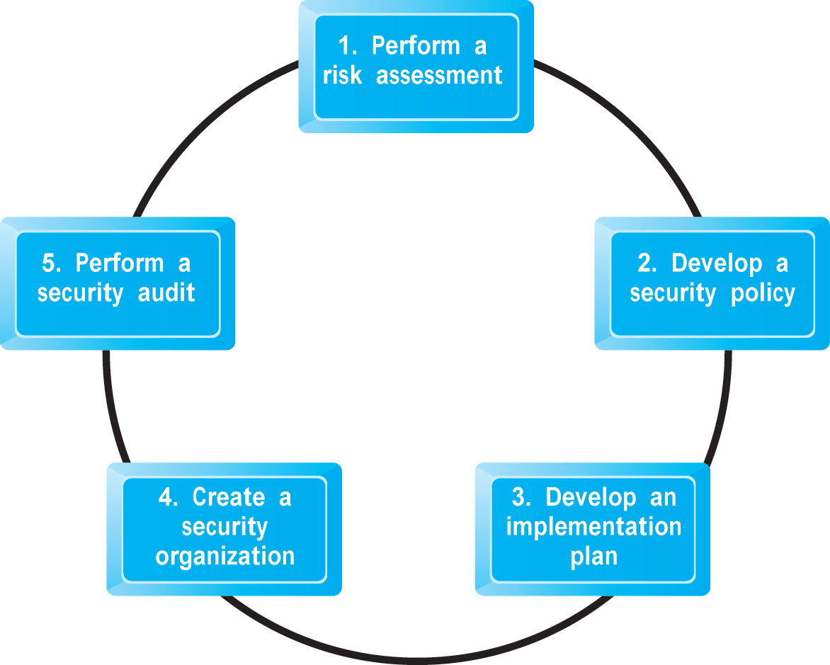
Figure 5.12 Developing an E-Commerce Security Plan
Notes:
Figure 5.12, Page 305.
There are five steps involved in building an e-commerce security plan.

Slide 51
The Role of Laws and Public Policy
Laws that give authorities tools for identifying, tracing, prosecuting cybercriminals:
U S A Patriot Act
Homeland Security Act
Private and private-public cooperation
U S-C E R T
C E R T Coordination Center
Government policies and controls on encryption software
O E C D, G7/G8, Council of Europe, Wassener Arrangement

Slide 52
E-Commerce Payment Systems
In U.S., credit and debit cards are primary online payment methods
Other countries have different systems
Online credit card purchasing cycle
Credit card e-commerce enablers
Limitations of online credit card payment
Security, merchant risk
Cost
Social equity

Slide 53
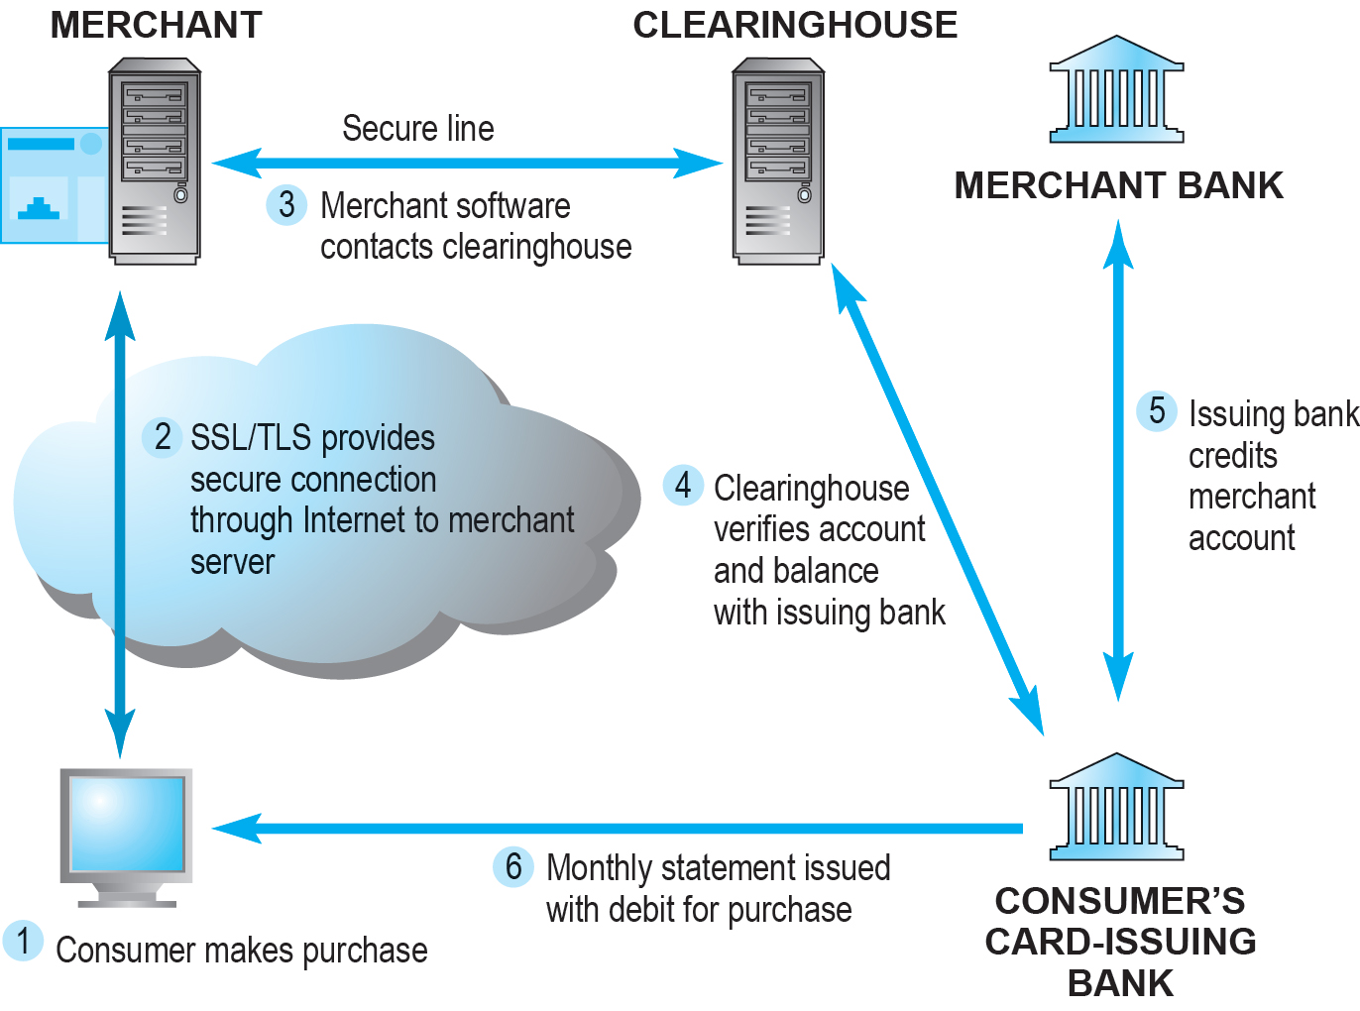
Figure 5.14 How an Online Credit Transaction Works
Notes:
Figure 5.14, Page 313.

Slide 54
Alternative Online Payment Systems
Online stored value systems:
Based on value stored in a consumer’s bank, checking, or credit card account
Example: PayPal
Other alternatives:
Pay with Amazon
Visa Checkout, Mastercard’s MasterPass
Bill Me Later
W U Pay, Dwolla, Stripe

Slide 55
Mobile Payment Systems
Use of mobile phones as payment devices
Established in Europe and Asia
Expanding in United States
Apple Pay, Android Pay, Samsung Pay, PayPal, Square
Near field communication (N F C)
Social/Mobile Peer-to-Peer Payment Systems
Sending money through mobile app or Web site
Regulation of mobile wallets and rechargeable cards

Slide 56
Digital Cash and Virtual Currencies
Digital cash
Based on algorithm that generates unique tokens that can be used in “real” world
Example: Bitcoin
Virtual currencies
Circulate within internal virtual world
Example: Linden Dollars in Second Life
Typically used for purchasing virtual goods

Slide 57
Insight on Business: Bitcoin
Class Discussion
What are some of the benefits of using a digital currency?
What are the risks involved to the user?
What are the political and economic repercussions of a digital currency?
Have you or anyone you know ever used Bitcoin?

Slide 58
Electronic Billing Presentment and Payment (E B P P)
Online payment systems for monthly bills
Over 55% of all bill payments
Four E B P P business models:
Online banking model (most widely used)
Biller-direct
Mobile
Consolidator
All models are supported by E B P P infrastructure providers

Slide 59
Careers in E-Commerce
Position: Cybersecurity Threat Management Team Trainee
Qualification/Skills
Preparing for the Interview
Possible Interview Questions

Slide 60
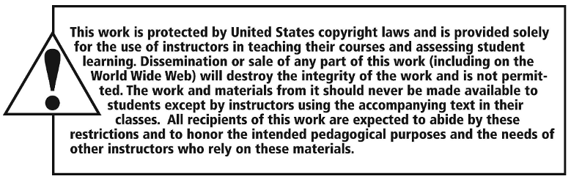
Copyright

